Slide 1
Tapestry Online Learning Journal
Workshop for parents and carers
Sara Liney – Assistant Head for EYFS and Year 1

Slide 2
What is Tapestry?
Tapestry is an online learning journal system
There is an app and browser version available
We can use it to record children’s learning and development using tablet devices and PCs
We can set you up as parents with your own secure logins so you can view, comment on and add your own observations to your child’s journal
When your child leaves, we can export a PDF copy of your child’s journal and a ZIP file including photos and videos for you
If they move to another setting also using Tapestry, their journal can be transferred across as well as your account

Slide 3
Why are we using Tapestry?
It creates a two way communication between us (the staff), and you
We can upload media, meaning you can see pictures and videos of what your child is really up to whilst they are with us
There are greater opportunities to extend your child’s learning at home – you can view next steps, add your own observations and communicate with us whenever you like
Unlike a physical, hard copy book, it’s easy to share with groups of relatives, such as extended families, separated parents and relatives living overseas

Slide 4
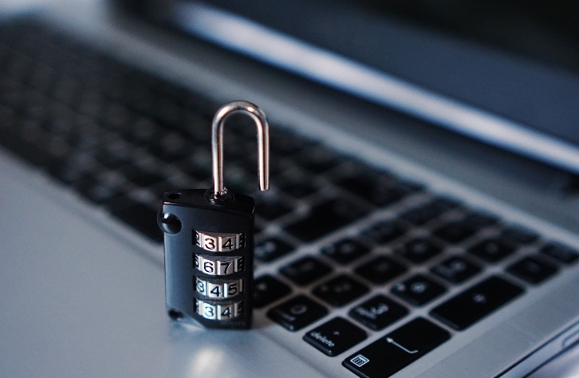
How is the data kept safe?
A password is required to access Tapestry, remember the stronger the password you set, the more secure your account is
You are linked manually to your child/children so you can only view observations for them
For more information about Tapestry security you can go on their website https://tapestry.info/security.html

Slide 5
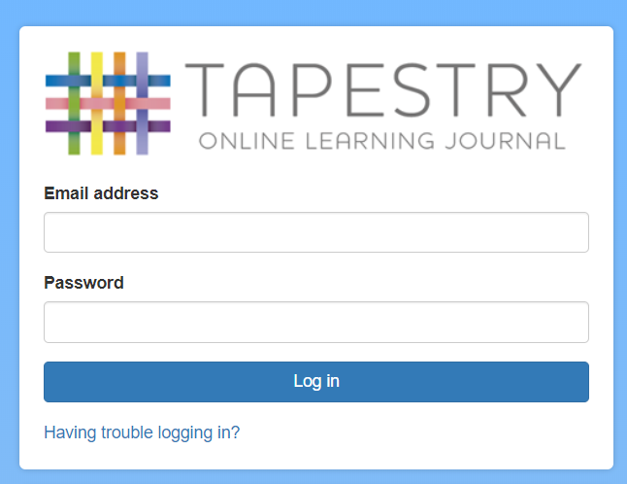
Logging in
To login to Tapestry we will need to have an email address for you
Once you activate your account you can then login using your email and password
You will be asked to set up a 4-digit pin for the app
You can reset your password by email if you forget it
Passwords are case sensitive
You can read this article for some guidance on how to set a strong and memorable password https://eyfs.info/forums/topic/47249-password-setting-advice/

Slide 6
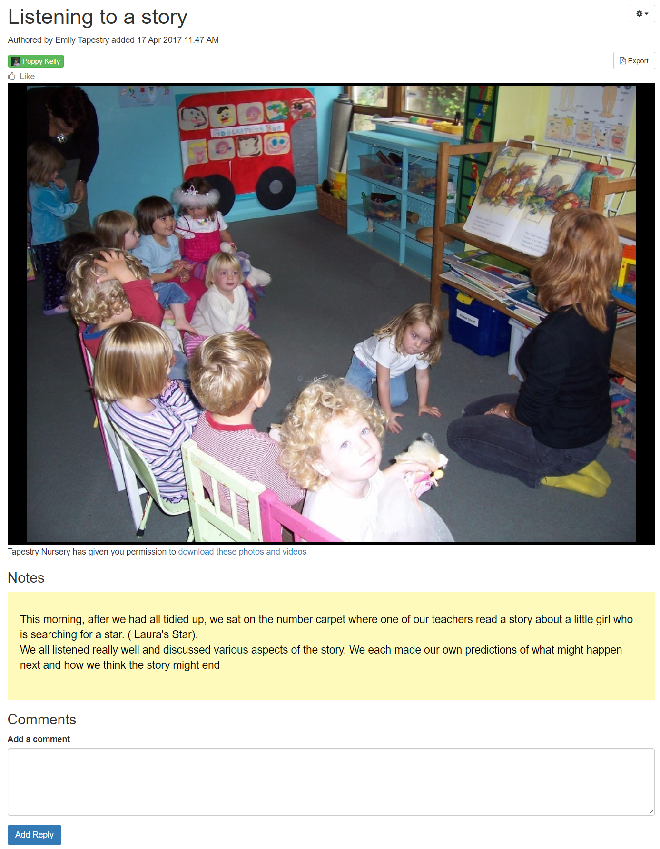
Our observations
When you login to your account you will be able to see any observations for your child that have been added to their journal
You will be able to see any photos/video attached to the observation, though if it’s a group one, this will depend on whether all of you giving your consent for other relatives to see photos/videos including your child
Underneath the media you will see notes which explain the learning we observe
You will also be able to add comments and ‘like’ the observation

Slide 7
Your observations
You will be able to upload pictures, videos and notes about your child’s progress at home
This will help us create a rounded picture of your child’s development
We will aim to share your child’s next steps in our observations. If you then observe your child succeeding in this, please share that information in an observation

Slide 8
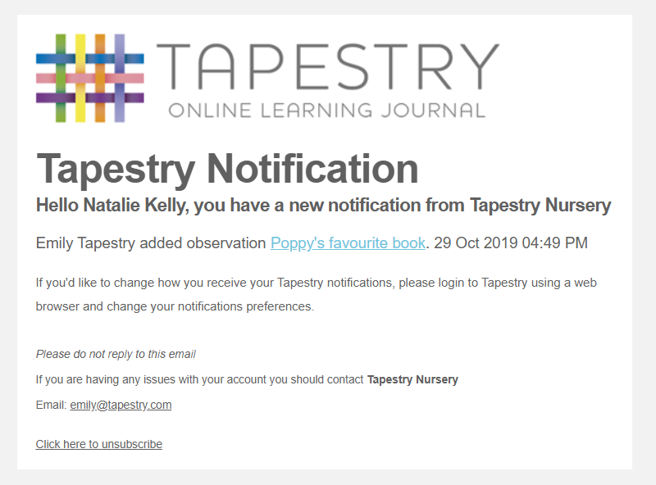
Notifications
If you would like to receive notifications it’s possible to receive email notifications immediately, daily or weekly
There are different notifications for things like new observations and observation comments
On the app (only on the new version) you can also receive push notifications

Slide 9
When will we get started?
You will have received our introductory letters and forms so you can grant your permission and provide an email address.
Please note that it is not possible for parents to both be set up using the same email address.
We should have your account created in the next couple of weeks, and you will receive a link to set a password for yourself. Remember to check your spam/junk folders for this.

Slide 10
Any questions?
Email: admin@canonbury.islington.sch.uk

