Slide 1
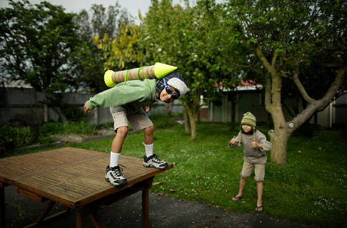

Session 3
Dare to take risks

Slide 2
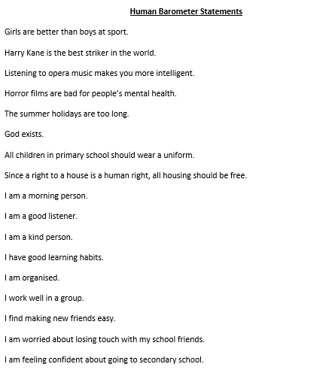
Task
Human Barometer activity.
I am going to read out some statements and I want you to indicate with your hand whether you agree with your importance (hand in the air) or disagree with their importance (hand to the floor).

Slide 3
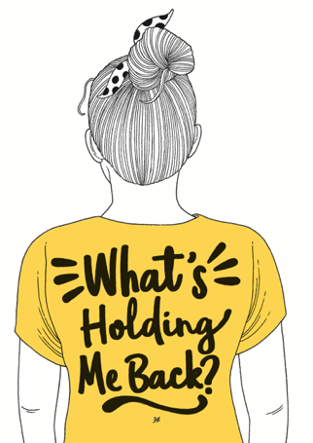
In Session 2, we decided we wanted to have …
And when we ask this question…
by having a GROWTH MINDSET.
the answer is often a FIXED MINDSET.
We agreed that to be AWESOME, you need to be brave and not be afraid of fear. You were going to think about what you could do to overcome a fixed mindset.

Slide 4
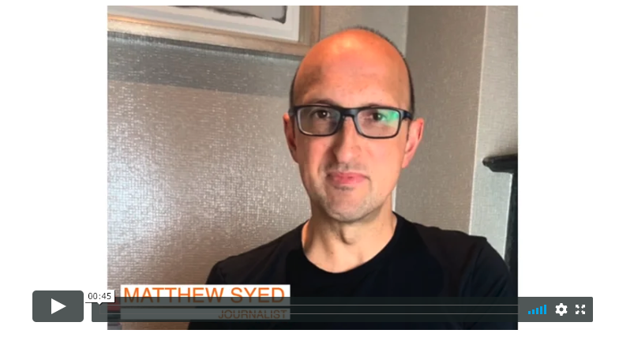

Here is Matthew Syed, for one last time, to introduce today’s session:
If you are reading ‘You Are Awesome’ alongside these sessions, then read from page 94 until the end. It doesn’t matter if you don’t read it all in one go because that is a BIG chunk of text!

Slide 5

Have you ever had a dream?
It is good to have dreams and goals in life…

Slide 6
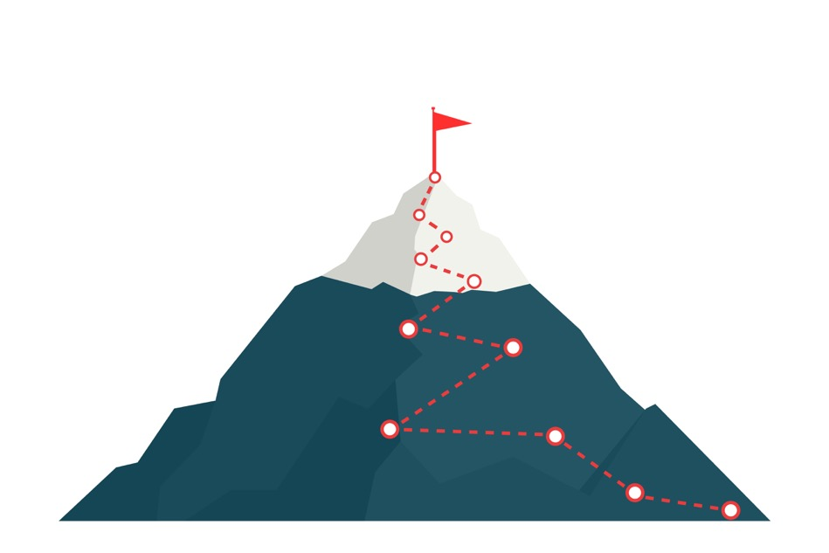
Dream big and dare to fail.
What does it mean?
Don’t be too scared to try.
Take a chance.
Take a risk.
Be fearless.

Slide 7
What are your hopes and dreams for secondary school?
You will be there from when you’re 11 to maybe 16 or 18 years old.
A lot will change in that time.
In your workbook, write down your thoughts about the following:
What do you hope you will achieve?
What kind of person do you hope you will become?
Write down three words that you hope people will say about you.

Slide 8
Are you scared of failure?
Each one of us will be scared of failure at some point in our lives BUT sometimes fear stops us from doing things.
It can stop you from achieving your goals and dreams.
What are you worried about ‘failing’ in secondary school?
Some Year 6 students say that they are worried about some of the following:
not making friends
not being able to do the work
that they won’t know where to go.

Slide 9

Why do we fear failure?
You don’t want to feel stupid.
You don’t want to be teased by others.
You don’t want to disappoint yourself or others.
You don’t want to be a ‘loser’.

Slide 10
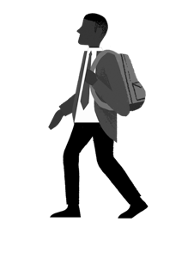
As you go to secondary school, you might worry about not getting things right.
I’m worried about not knowing what to do.
I am worried about getting lost.
I am worried about not doing well on tests.
I worry that I won’t make friends.
I’m worried I am going to say or do the wrong thing.
Not all of these things would mean you had failed. You can always start again and keep trying.
Everyone is there to help you!

Slide 11
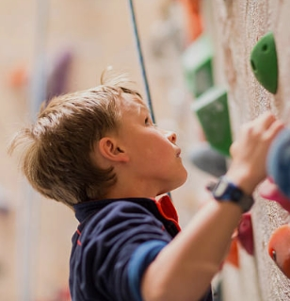
How can you view failure differently?
Start to see failure as an incredible learning experience.
Learn a lesson each time you fail.
Know that mistakes can help you grow and move forward.

Slide 12
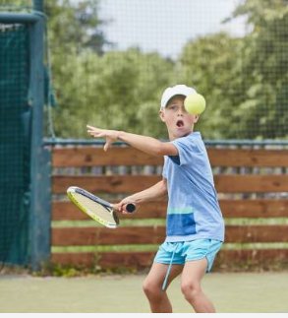
Do you know where your learning actually happens?
Learning happens from hours of practice.
Serena Williams is a tennis player.
Serena started playing tennis when she was three years old and she played for two hours a day!
Serena loved tennis and it was her passion.
Over time, she made many mistakes but practised for thousands of hours.
Read page 104 of ‘You Are Awesome’ to find out more.

Slide 13

Where does learning actually happen?
Child prodigies are not just born with skill; they have to work and work at it!
It is all about the PRACTICE!
Mozart was a child prodigy and composer.
He started composing pieces for the violin and piano by the age of 6. He was a musical genius.
Mozart’s father put him through hours of musical training from the age of 3! By the time Mozart was 6, he’d been put through 3,500 hours of practice.
Read more on page 104 of ‘You Are Awesome’.

Slide 14
Choking is when you are under pressure and are nervous, adrenalin is pumping through your veins and you suddenly find it hard to think straight or how to do things you have done so many times before.
RORY MCILROY is a famous golfer
Page 144 ‘You Are Awesome’

Slide 15
“I will not lose, for even in defeat, there’s a valuable lesson learned, so it evens up for me…you learn more in failure than you ever do in success.”
Jay-Z

Slide 16
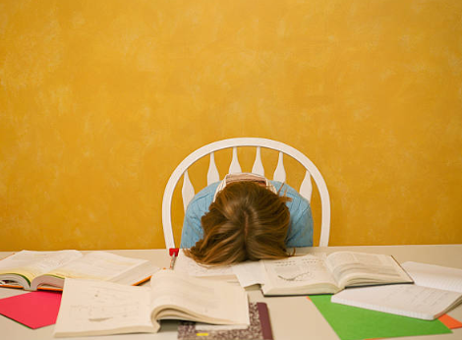
Sometimes we ‘choke’ in pressure situations
Choking is the kind of failure that results from thinking too much.
Choking can happen when you are in a pressured situation such as an exam or a sports match.
For example, you might be so worried about how to get somewhere, you forget for a moment how to get there!

Slide 17
What happens if you panic under pressure?
Here are some of Matthew’s top tips.
1. Tell yourself how you feel is NORMAL. Everyone gets anxious. Try to go for a walk around and shake your arms. This can help to burn off your adrenaline.
2. Focus on your breathing. Going from being fine to a state of anxiety can trigger you into a panic. Focusing on your breaths in and out can help you feel calm.
3. Don’t overthink. Try to zone out from where you are and what you are doing and focus on the task itself so that you can be on auto pilot.
Read page 141 from ‘You Are Awesome’ to find out more.

Slide 18
What happens if you panic under pressure?
4. Put things into perspective.
Remember that life will continue, no matter how you do or what the outcome is. It is just a challenge and a learning opportunity. Just do your best.
5. Do a ritual which calms you or focuses you. This could be listening to music, reading a quote, doing some breathing or visualising an outcome.
6.Keep trying. Performing under pressure is a skill. The more you do it, the better you will get. Don’t let a meltdown put you off or give up.
Read pages 142-143 ‘You Are Awesome’ to find out more.

Slide 19
Don’t be afraid to fail and here is how…
Change your attitude about failing.
Remember that we have to make mistakes to learn.
Understand that some things in life are hard and take work.
Keep a positive mind, even when you get setbacks.
Try and try again.

Slide 20
Think again about failure. That is how we learn.
It is how we become determined.
Think of something that didn’t go quite as you had expected: what did it teach you? Jot that down in your workbook.

Slide 21
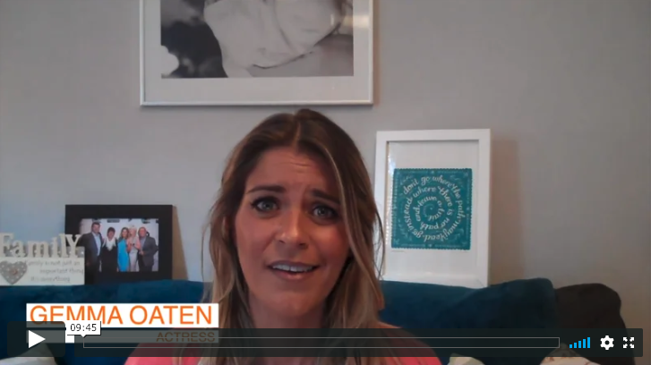
Gemma knows the importance of not giving up and always trying again.

Slide 22

Remember to give EVERYTHING your best shot!

Slide 23
© 2020 The PiXL Club Ltd and Hachette UK
This resource may be shared with any primary school Year 6 student in its current form, and parts thereof, to enhance your transition work with students. All opinions and contributions are those of the authors. The contents of this resource are not connected with, or endorsed by, any other company, organisation or institution.
If there are any inadvertent omissions or errors in the acknowledgements or usage, this is unintended and we will remedy these on written notification.
Hachette UK own 'You Are Awesome' by Matthew Syed and 'Go Big' by Matthew Burton, which may be purchased by individuals and schools, should they wish to do so to enhance these resources for students. 'You Are Awesome' illustrations copyright © Toby Triumph. 'Go Big' illustrations copyright © Chris Madden.

