Slide 1
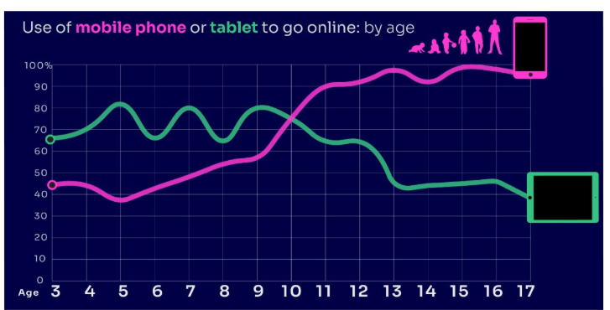
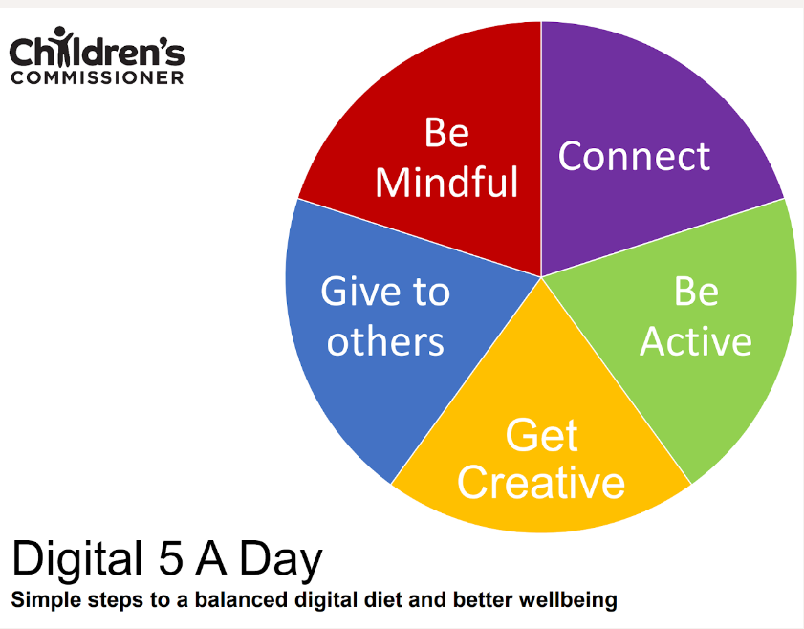
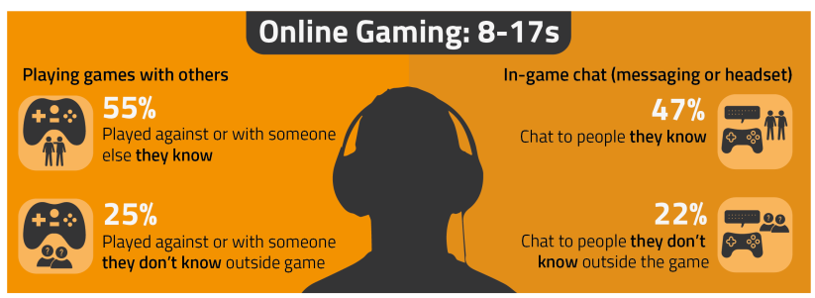
PARENT ONLINE SAFETY
A ready to use Presentation for Schools, Community Groups and Youth Centres
Notes:
This presentation brings together:
- the latest research and key findings on children’s and young people’s online use and risk
- parents’ views about their children’s media use, devices and supervision to monitor or limit use
- suggested resources and tips to empower parents to keep up with the latest trends/apps and games, manage controls and settings, and talk to children about risk - from bullying and sharing content, to extremism and gangs

Slide 2
SCREENTIME

Slide 3
WORRIED about their SCREENTIME??
Do you know HOW LONG YOUR CHILD SPENDS online daily?
Children spent an average 3 hours 5 minutes per day accessing the internet, across smartphones, tablets and computers
Four in ten (39%) parents of children aged 3-17 report finding it hard to control their child’s screentime
Visit screentime.lgfl.net for advice and tips to manage screentime
Source: Children and parents: media use and attitudes report 2024
Notes:
Parents’ concerns about their child’s screentime increases with age - Overall, four in ten (39%) parents of children aged 3-17 report finding it hard to control their child’s screentime. This increases with age, going from a third (34%) for parents of 3-4-year-olds to half (49%) of parents of 16-17-year-olds.
Threequarters (74%) of parents aged 3-4 agreed that their child had a good balance, compared to just over half of parents of older children (56% and 55% for parents of children aged 12-15 and 16-17 respectively).

Slide 4
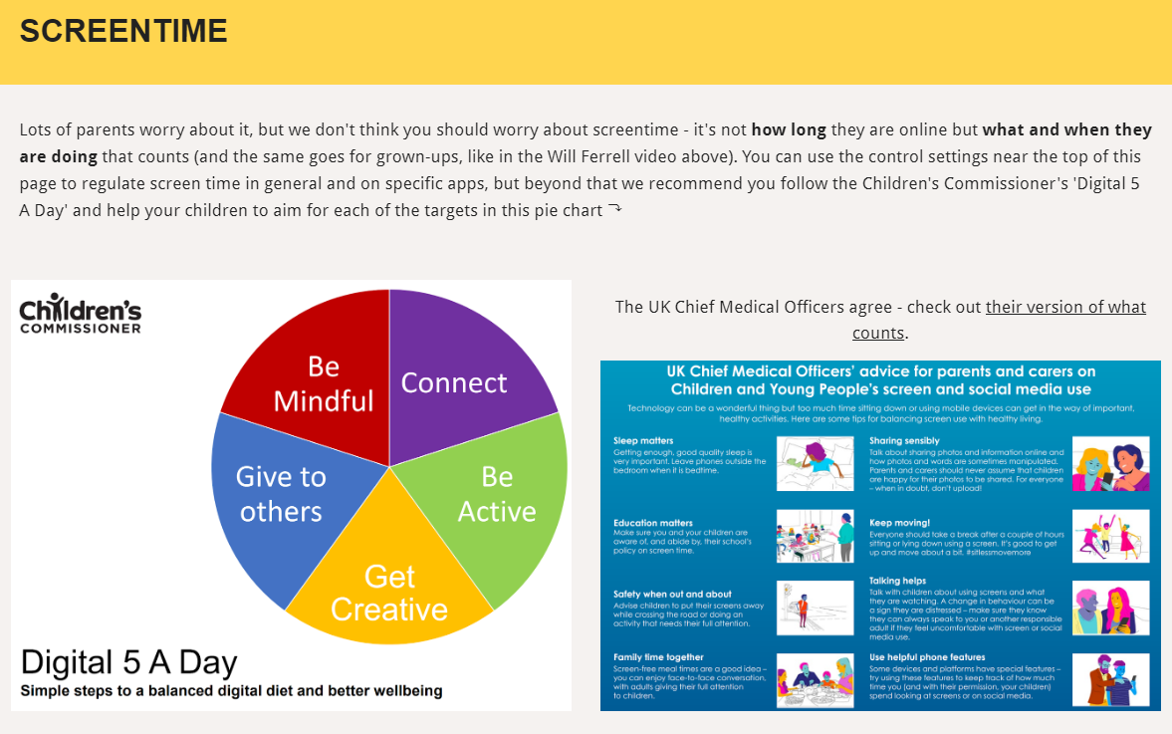
Visit parentsafe.lgfl.net/ for advice and tips to manage screentime
Notes:
ASK – Do you think lots of screentime is a bad thing generally? Why? How long is OK?
SHARE - World Health Organization (WHO) recommendations and research:
Infants (1 – 2 years) are recommended no screentime, whilst for 2 – 4-year-olds sedentary screen time should be no more than 1 hour; less is better.
When sedentary, engaging in reading and storytelling with a caregiver is encouraged
Improving physical activity, reducing sedentary screen time and ensuring quality sleep in young children will improve their physical, mental health and wellbeing, and help prevent childhood obesity and associated diseases later in life.
TELL – It’s not how long they are online but what and when they are doing that counts - take them through the UK Chief Medical Officer’s advice poster above for examples
EXPLAIN – the Digital 5 A day gives children and parents easy to follow practical steps to achieve a healthy well balanced digital diet, by encouraging them to reach of the targets in the pie chart – share some examples with them https://www.childrenscommissioner.gov.uk/digital/5-a-day/

Slide 5
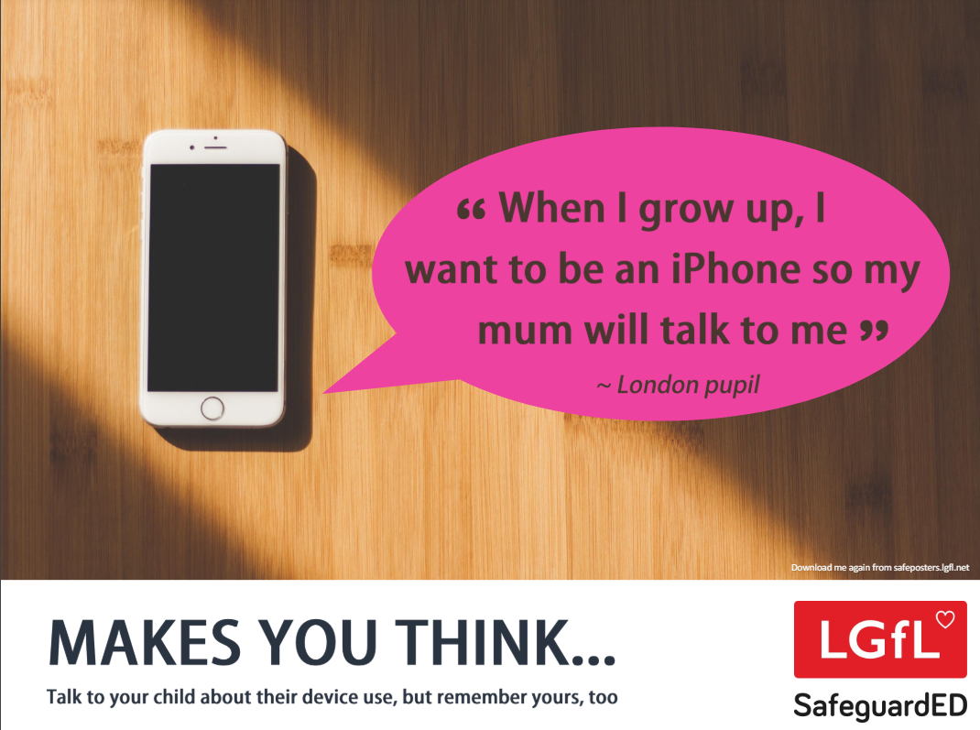
How does your child feel about YOUR SCREENTIME vs THEIRS?
45% of 8-11s feel that their parents’ screentime is too high
35% of 8-17s feel that their own screentime is too high
Source: Children and parents: media use and attitudes report 2024
Notes:
REMIND – it’s important to model good behaviour when it comes to device use, as children will follow our example. The same goes for ‘sharenting’ (see slide 22)

Slide 6
Notes:
PLAY VIDEO – ‘Life Online - What Grownups Just Don't Get!’
This video is part of our playlist on what children and young people actually think about some of the top topics and hot potatoes of the day in 2024. You can discuss key points from this to facilitate conversations to break down barriers to keeping children safe online.
https://youtu.be/Lde52EtjljQ?si=QZSHL0Gn31LRCO1T

Slide 7
AGE REQUIREMENTS

Slide 8
Are YOU aware of the MINIMUM AGE REQUIREMENT for social media?
More than a third (36%) say they would allow their child to have a profile on sites or apps before they had reached the minimum age.
84% of parents of 3-17s were aware of a minimum age requirement to have a profile on social media apps
BUT ONLY
32% of parents knew the
correct age requirement
(13 yrs)
Find ratings and reviews for parents on apps, games and social media at www.commonsensemedia.org
Source: Children and parents: media use and attitudes report 2024
Notes:
Only a third of parents know the correct minimum age requirement for most social media platforms. Although the majority of parents of all 3-17s (84%) are aware that there are minimum age requirements for using most social media apps or sites, only a third (32%) think, correctly, that the minimum age requirement for most social media sites and apps is 13. However, a further 31% put the minimum age at 14 or above. More than a third (36%) of parents of all 3-17s say they would allow their child to have a profile on sites or apps before they had reached the minimum age required. While this is unchanged at an overall level since 2022, there has been an increase in the proportion of parents of all 5-7s who say they would do this (30% vs 25% in 2022).

Slide 9
What about YOUNG PEOPLE?
Nearly eight in ten children are aware of minimum age requirements
Four in ten admit to giving a fake age online to access a new app/site
Up to a quarter had changed their date of birth on their profile since initially setting it up:
Facebook (24%)
TikTok (23%)
Instagram and X/Twitter (both 19%)
Children’s Online User Ages 2023 Quantitative Research Study
Notes:
Up to a quarter of children aged 8-17 said they had changed their date of birth on their profile since initially setting it up.
• This was most likely to be cited for Facebook (24%) and TikTok (23%), followed by Instagram and X/Twitter (both 19%).
• Proportions doing this were higher among 8-12s for both TikTok and Instagram.
-

Slide 10
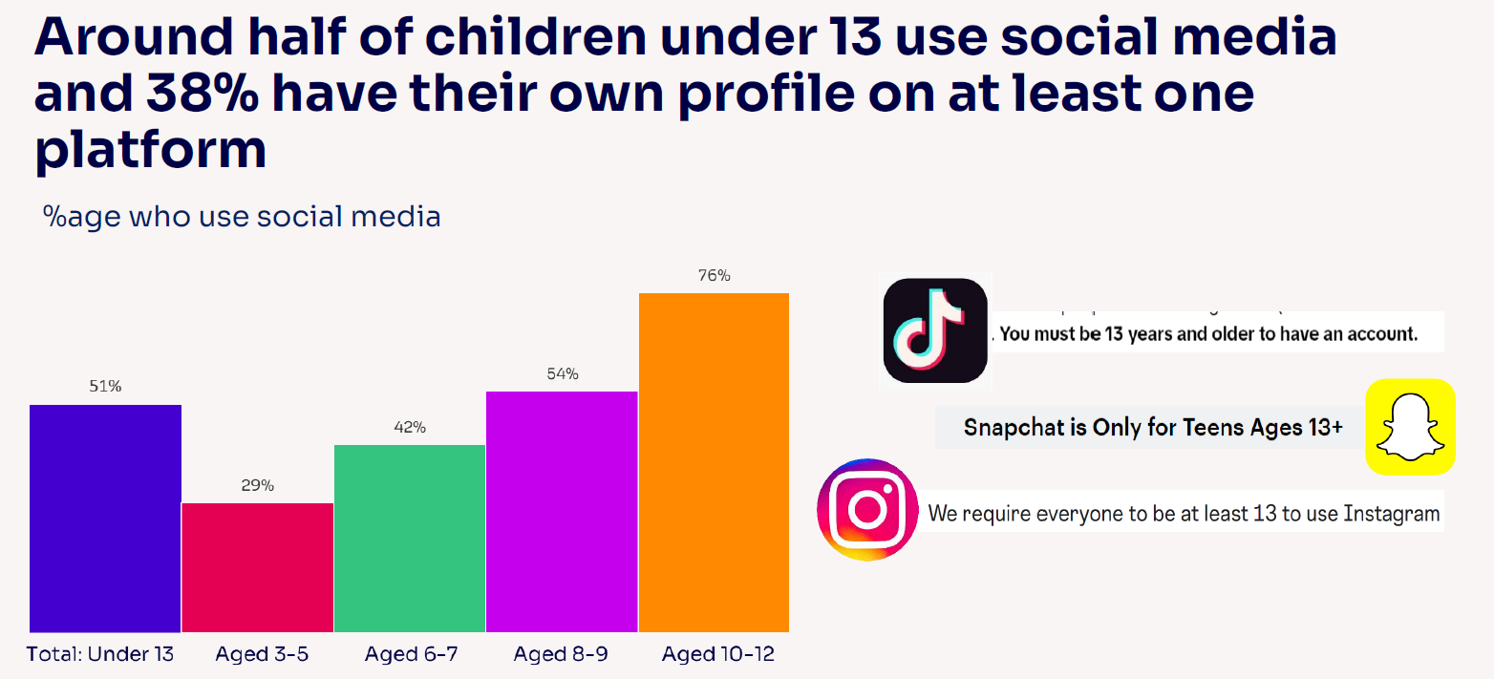
Given the 13+ minimum age requirement on most of these social media platforms, it is notable that half (51%) of children under 13 use them.
Source: Children and parents: media use and attitudes report 2024

Slide 11
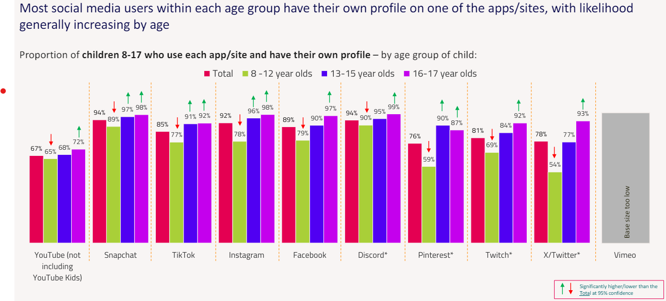
Children’s Online User Ages 2023 Quantitative Research Study
Notes:
*CAUTION - Low base size, figures are indicative only (Ofcom)

Slide 12
Young people can get around age restrictions on apps and websites, increasing the risk of them coming to harm online
To understand the extent to which children are bypassing age checks, Ofcom researched how many children have online profiles that make them appear older than they actually are.
Source: Children and parents: media use and attitudes report 2024
Notes:
ASK – Why does this matter?
TELL:
Many children have online profiles that make them appear older than they actually are – exposing them to content inappropriate for their age and harmful online interaction with other users; for example: peer to peer pressure, commercial advertising and adults posing as children or young adults with the intention to groom or exploit them for sexual, criminal, financial or other purposes
Addictive algorithms can make it harder to take a break and maintain a healthy balance between time on and offline
Algorithms can also target content similar to what you’ve already selected. This can prevent you from finding new ideas and perspectives, create misinformation and reinforce stereotypes.

Slide 13
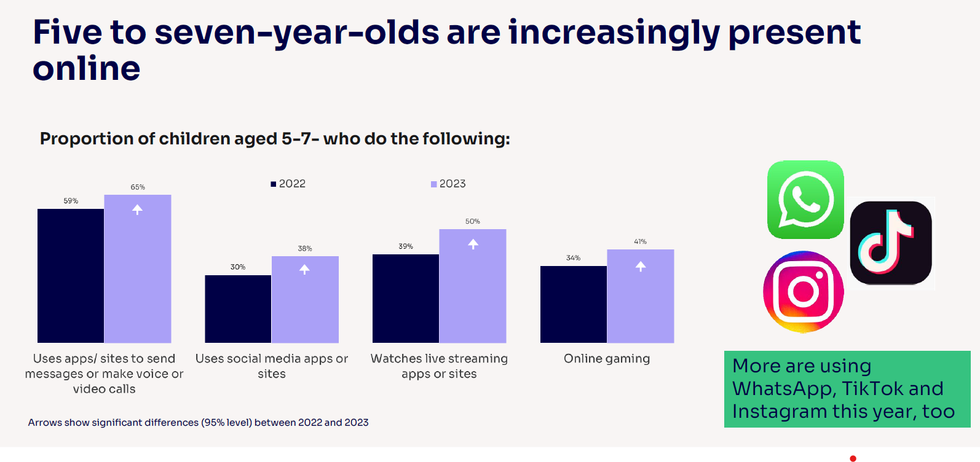
Notes:
Five-to-seven-year-olds are becoming increasingly present online, which may pose greater risks for them: Compared to last year, a higher proportion of all 5-7s use apps/sites to do each of these activities:
send messages or make voice/video calls (from 59% to 65%)
use social media apps or sites (from 30% to 38%)
watch livestreaming apps or sites (39% to 50%)
game online (34% to 41%).
Children this age are also more likely to use WhatsApp (37% vs 29%), TikTok (30% vs 25%), Instagram (22% vs 14%) and Discord (4% vs. 2%) compared to last year.

Slide 14
5–7-year-olds are also independent in their use of certain sites/apps!
Many have their own profiles on several social media platforms:
YouTube/YouTube Kids (48%)
WhatsApp (11%)
Instagram
(9%)
32% of parents reported that their child uses them on their own:
Three in ten (30%) agreeing they ‘would allow [their] child to have a profile on these sites or apps before they had reached the minimum age
Parents increasingly likely to say they would allow their child to have a social media profile
Notes:
Linked to this, Ofcom ask parents of children who use social media apps/sites whether their child uses these independently or not, and 32% of parents of 5-7s in this category reported that their child does use them on their own, with a further 42% of parents saying they use social media with their child. Therefore, 5-7-year-olds are not only increasingly present online, but some are also independent in their use of certain sites/apps.

